Slide 1
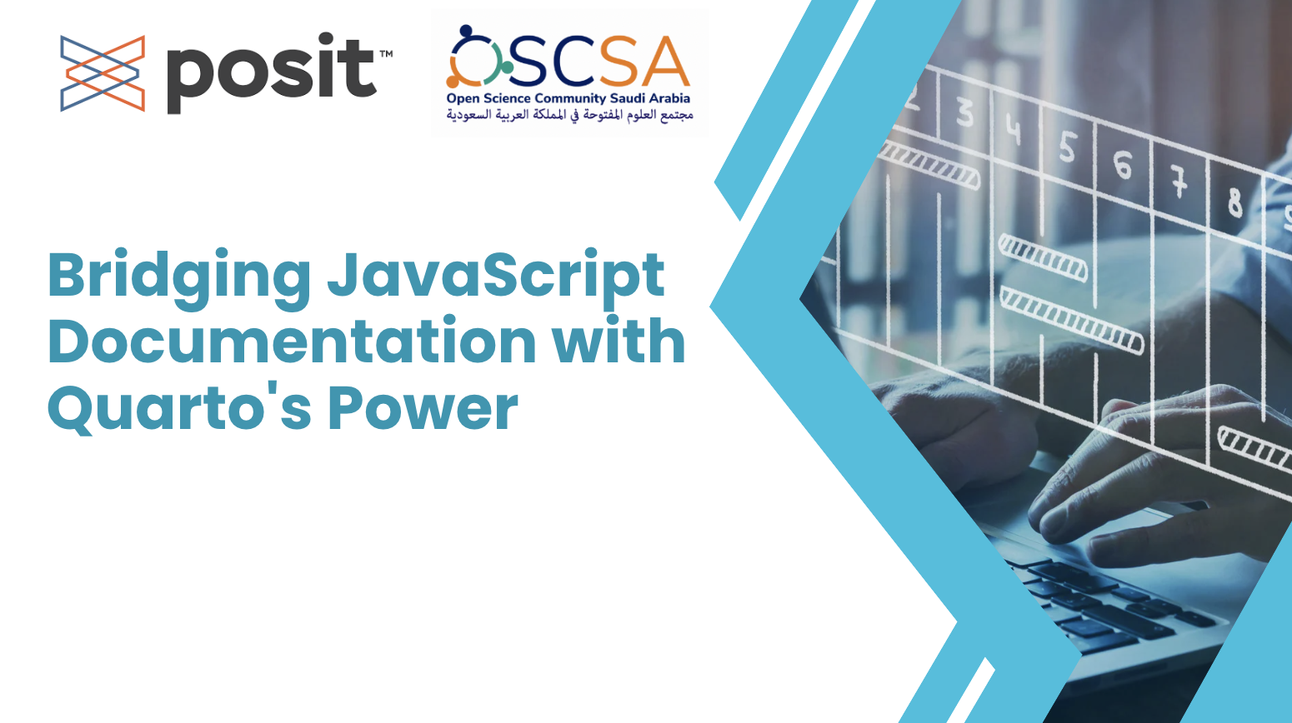







Bridging JavaScript Documentation with Quarto's Power
By Richie Moluno
Richie Moluno
Batool Almarzouq
Lamis Elkheir
Richie Moluno
Goodnews Sandy
Batool Almarzouq
Lamis Elkheir
Richie Moluno
Goodnews Sandy

Slide 2

Documentation
Notes:
OPENING HOOK Did you know that JavaScript powers over 95% of the web, yet many projects struggle with outdated and inconsistent documentation? How many times have you had to break your coding flow to document your work, only to realize later that the documentation is already outdated?

Slide 3
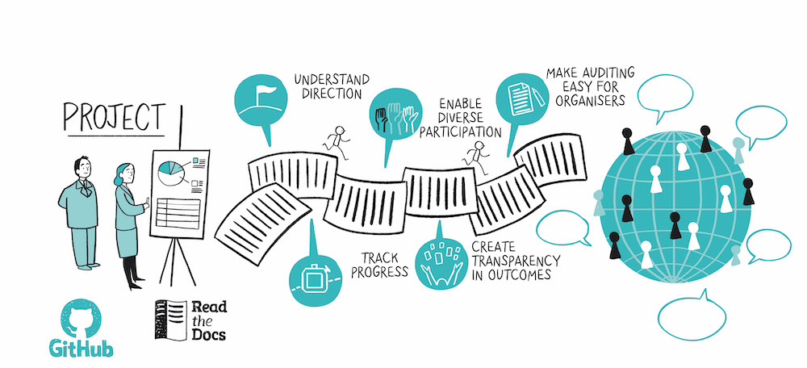
Good documentation
93% of developers consider comprehensive documentation crucial for open-source projects.
Image by Scriberia for The Turing Way , CC-BY 4.0, Zenodo: https://zenodo.org/record/7716933
Notes:
Developers often face tight deadlines, making it challenging to allocate sufficient time for thorough documentation.

Slide 4
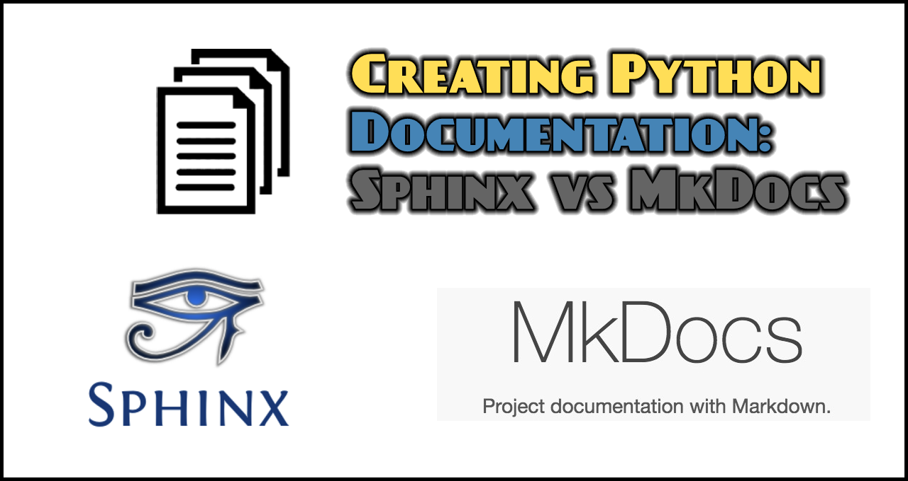



What already exist?
Notes:
Most of the existing tools are not on JS and they do not support localization

Slide 5
Complications/Challenges
It is not supporting multilingualism especially RTL languages and non-latin scripts
No flexibility in the design of the docs
Doesn’t support JS
Notes:
Inconsistent and outdated documentation
- Devs need to dedicated separate time to document new code. (Jsquarto solves this by allowing you write the documentation while coding)

Slide 6
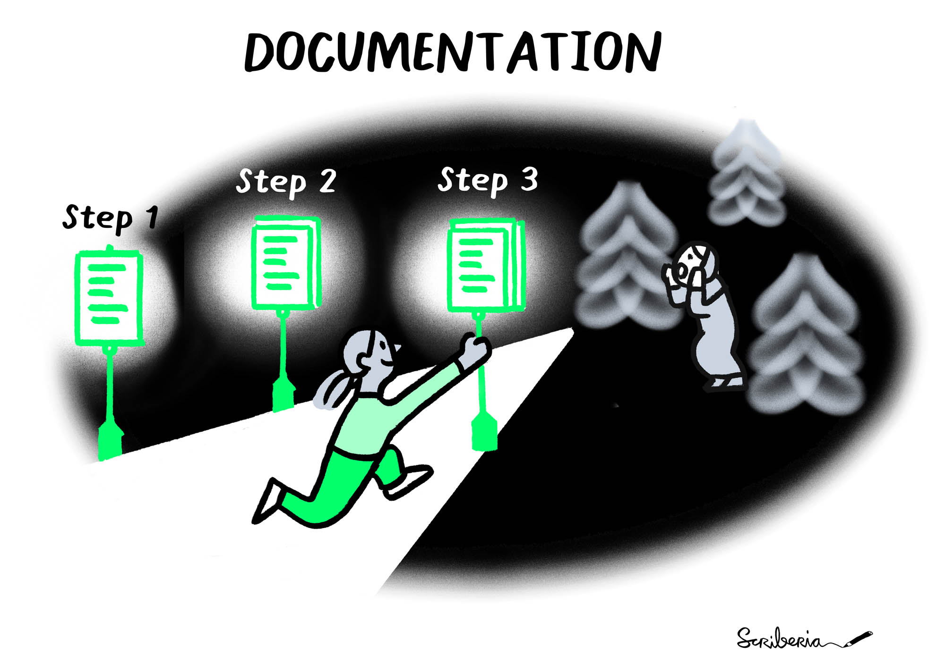
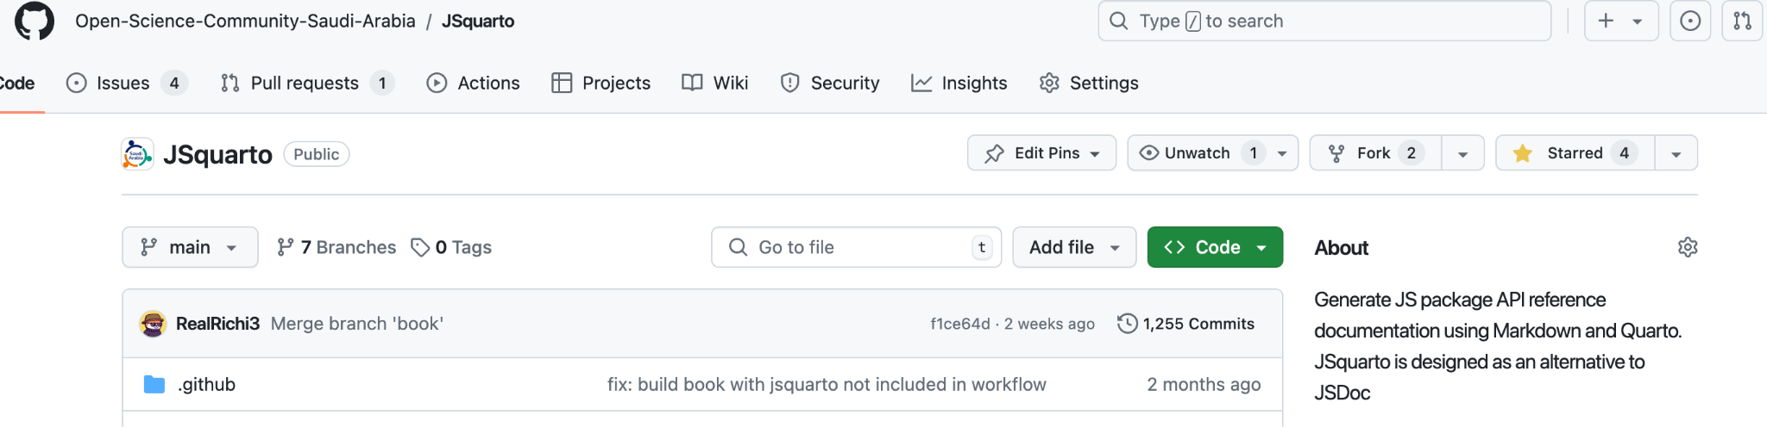
Can we improve process of generating JavaScript Docs with Quarto?
Inspired by quartodoc, we created JSQuarto

Slide 7
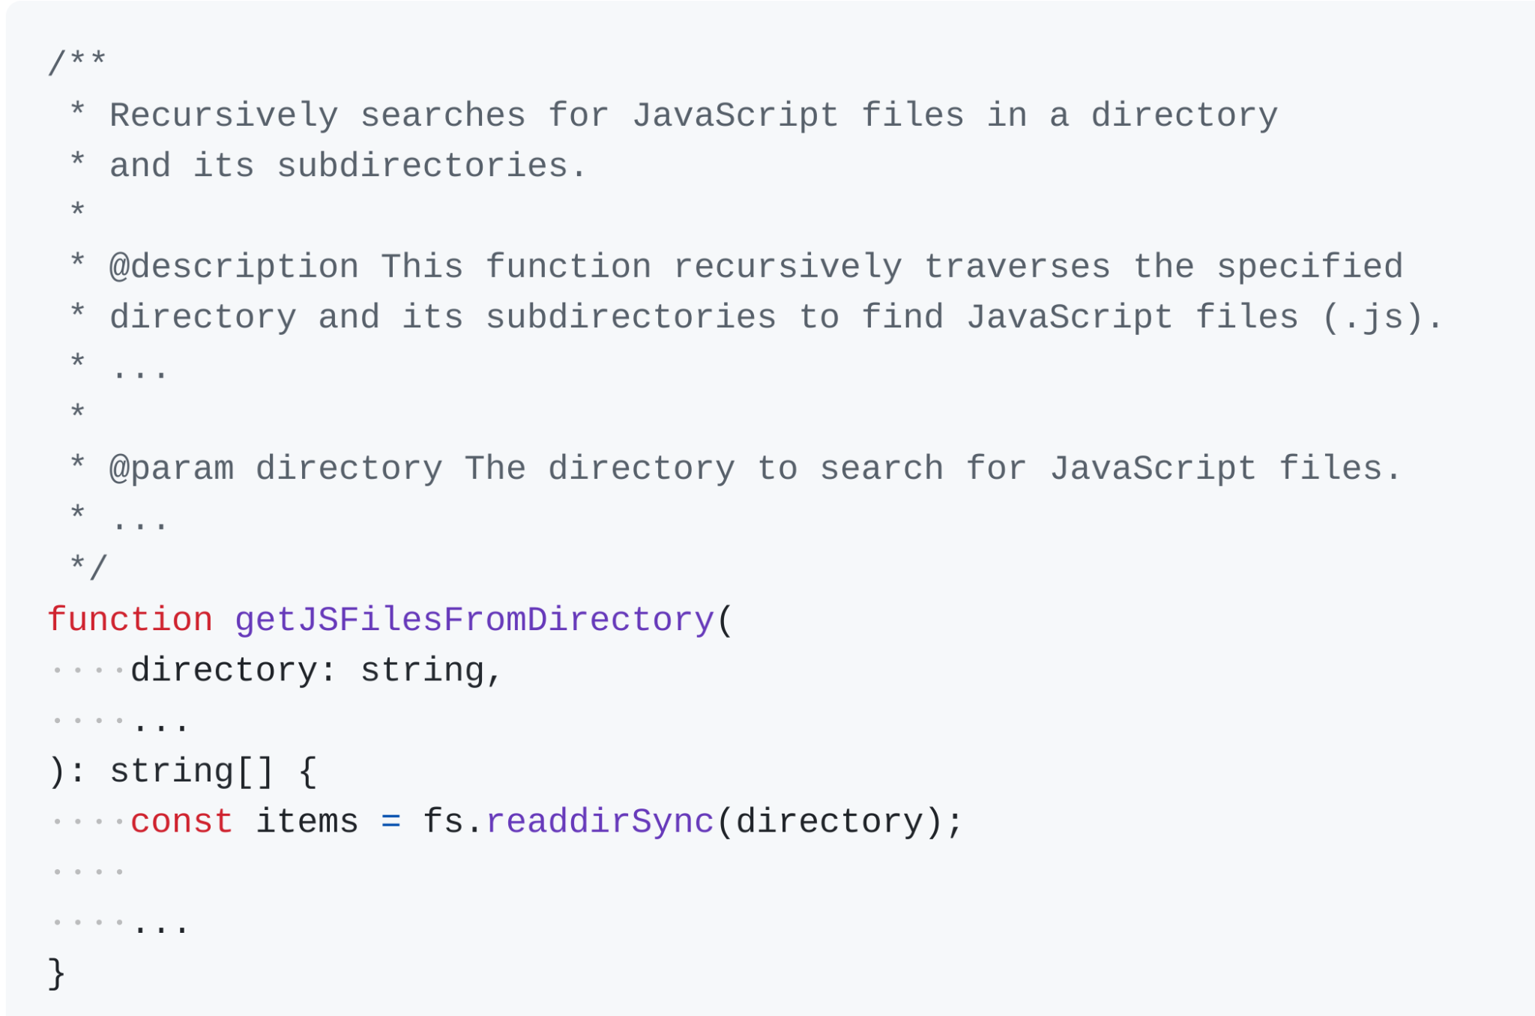
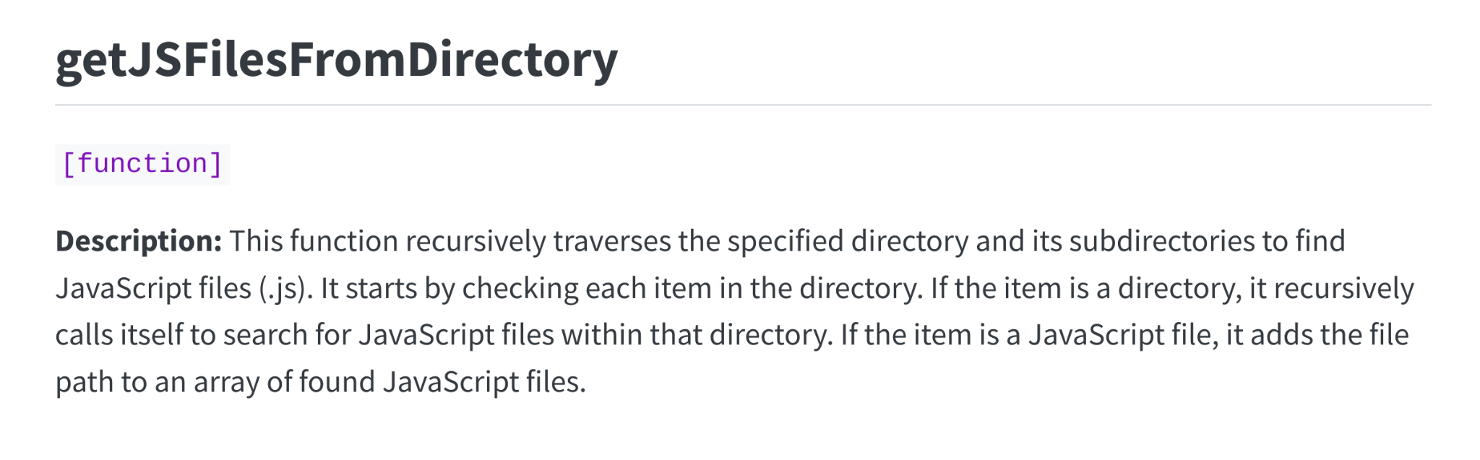

Generating the Doc

Slide 8
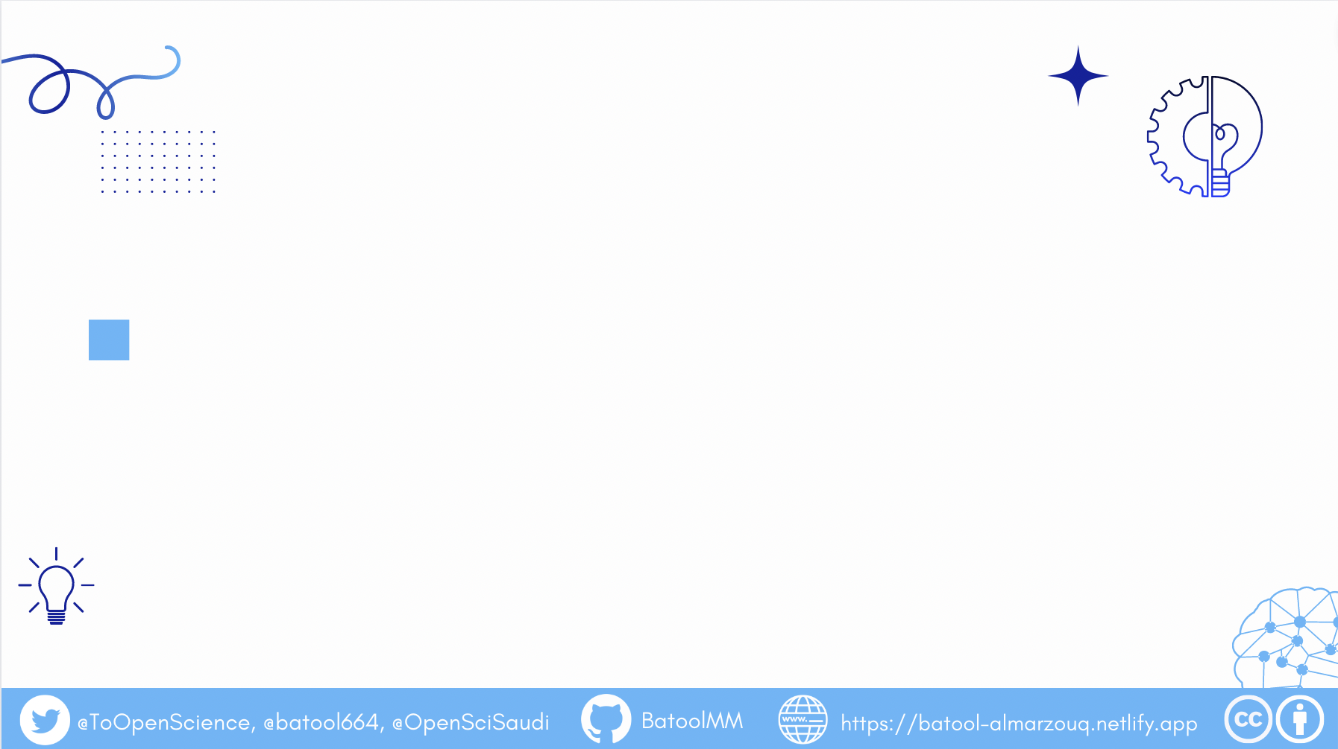
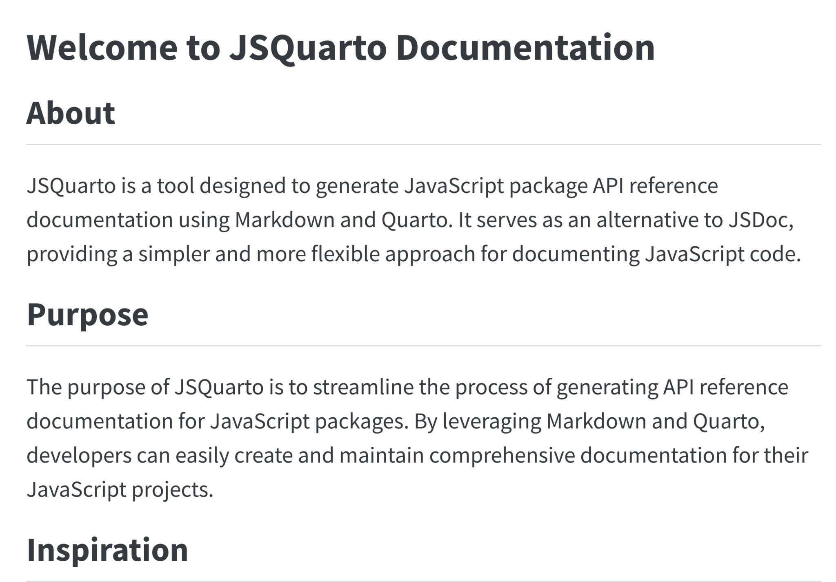
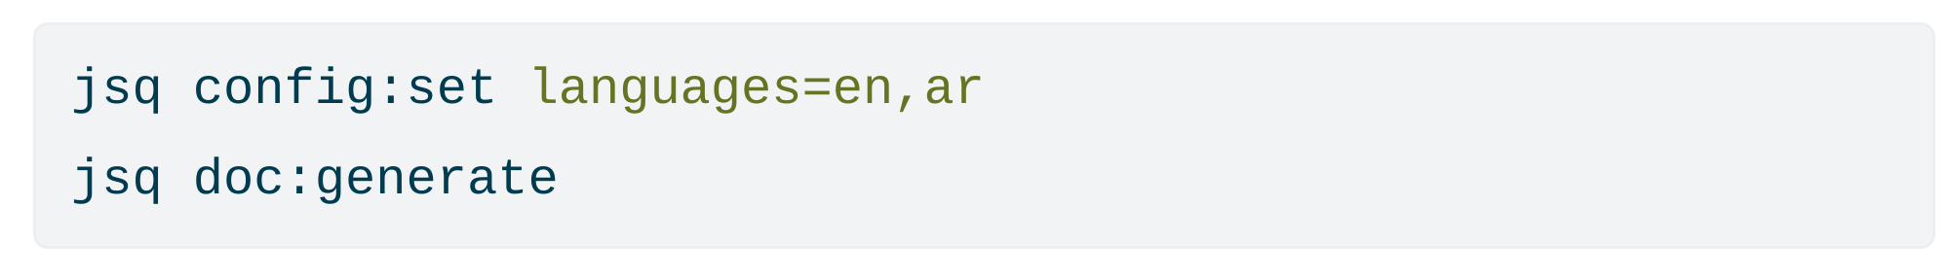
Generating the doc

Slide 9

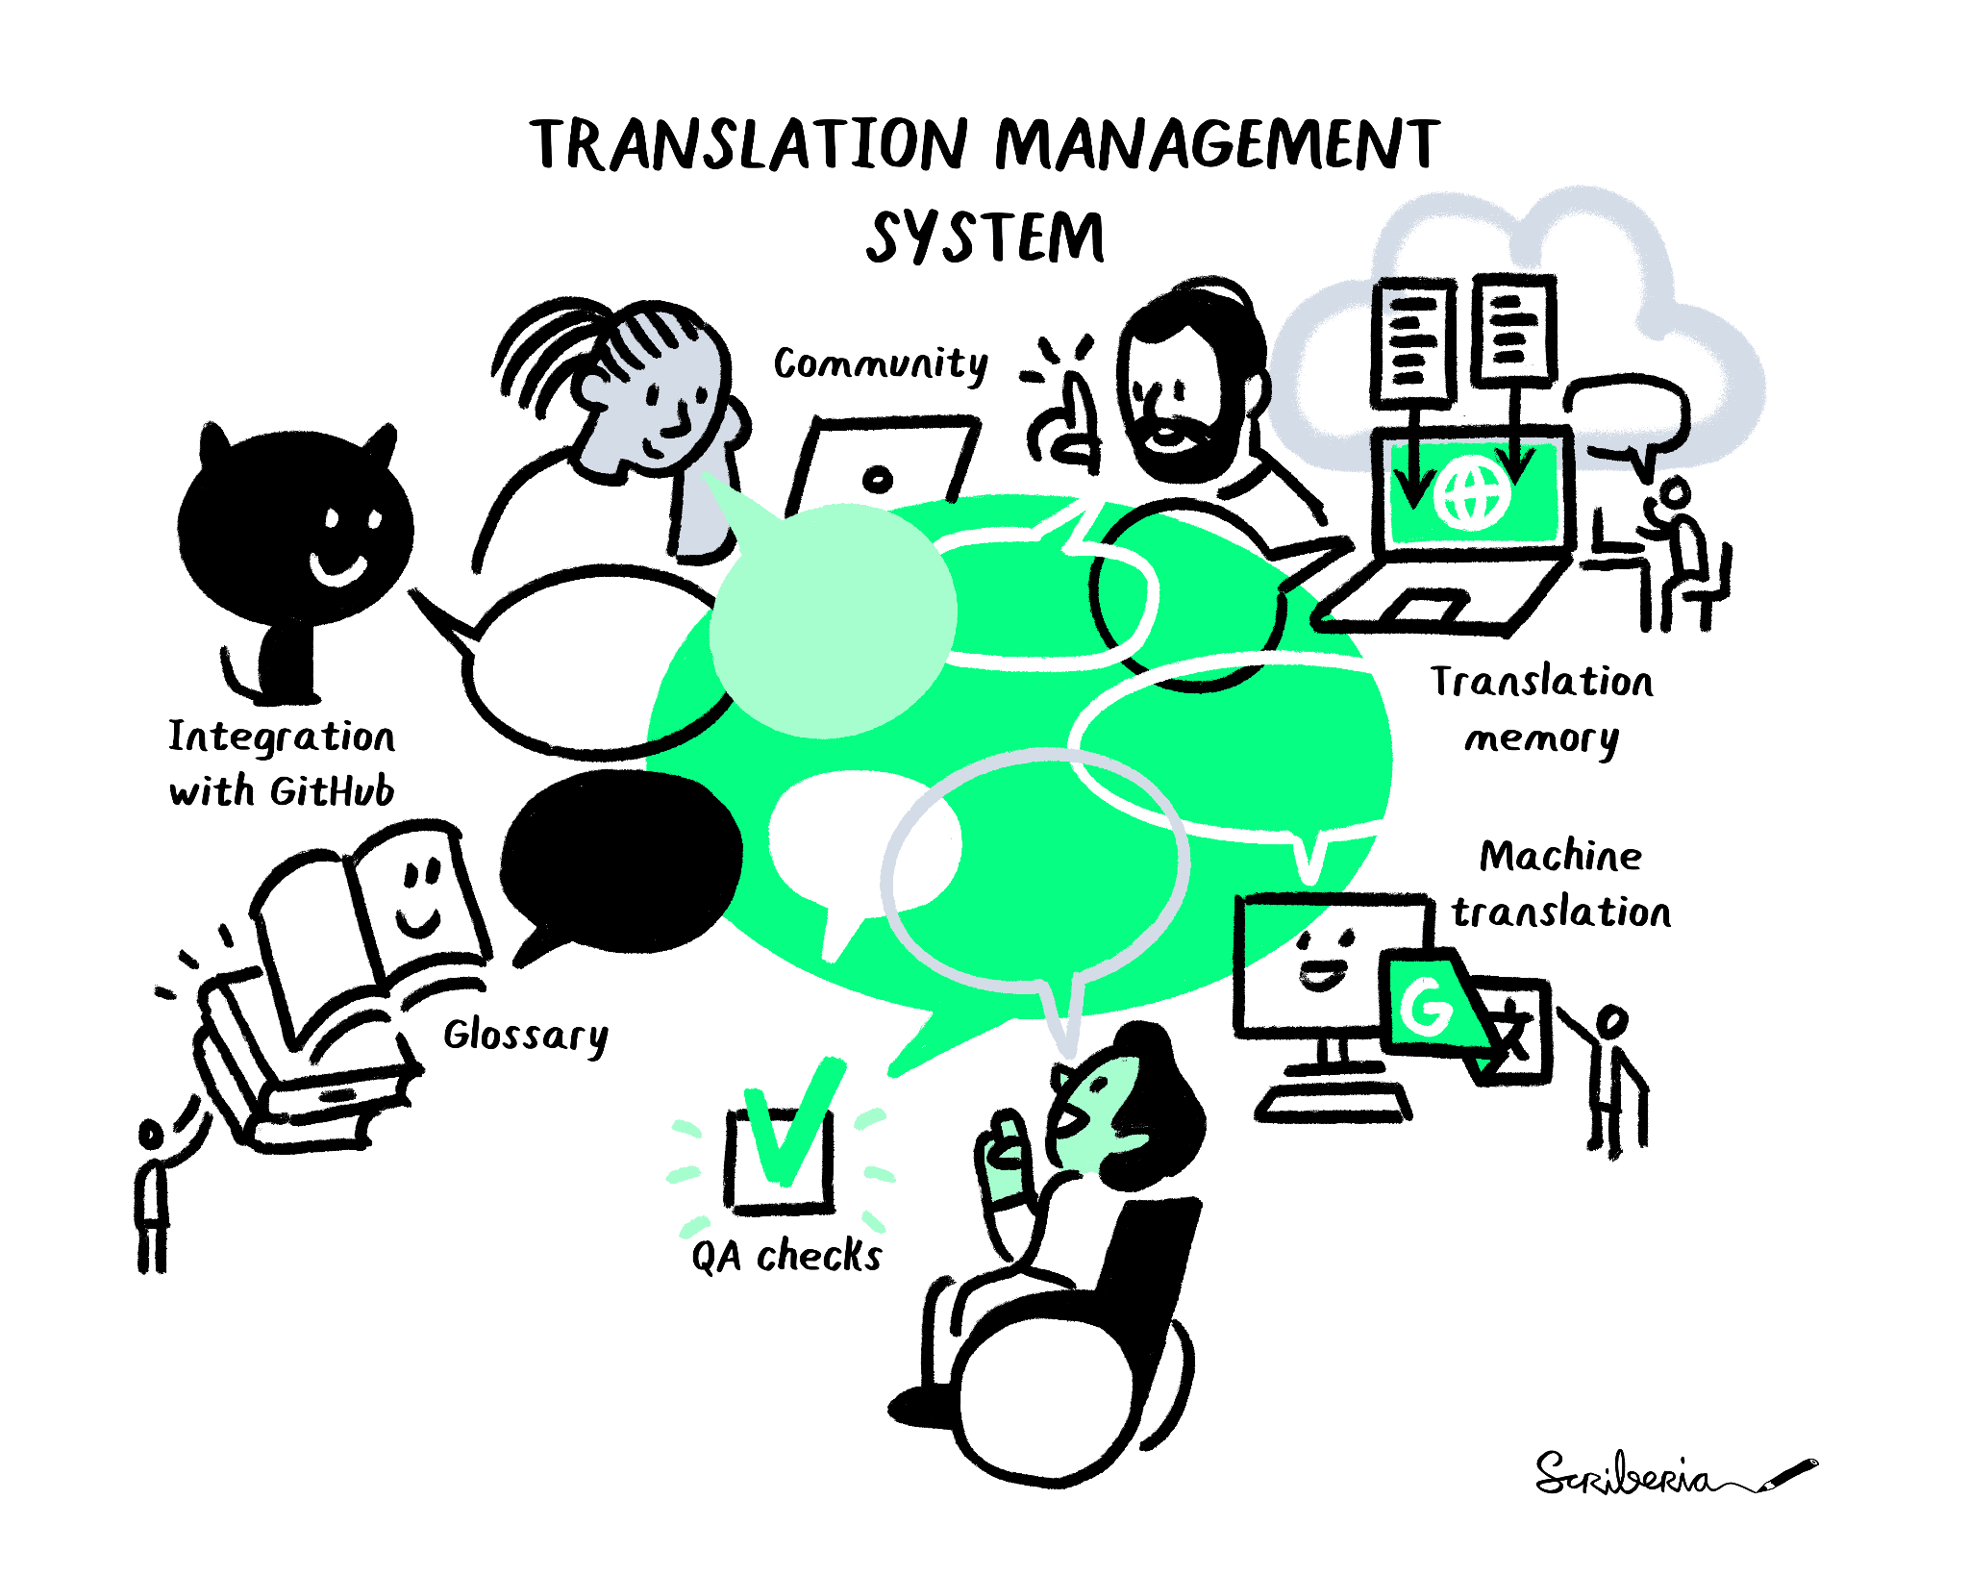

Multilingualism in many ways
It can be integrated with Translation Management System particularly crowdin which do machine translation, have translation memory, create glossary, QA checks

Slide 10
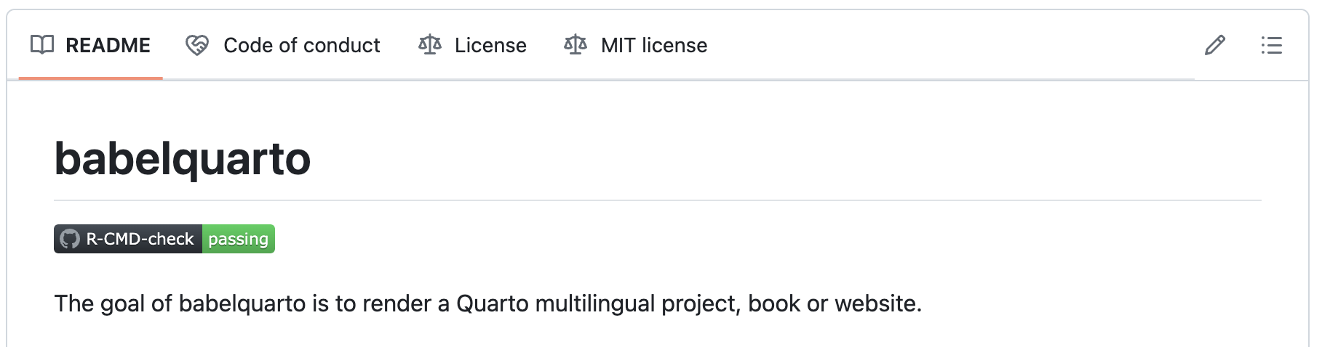
Multilingualism in many ways
Also, work with babelquarto package which was created by Maëlle Salmon

Slide 11
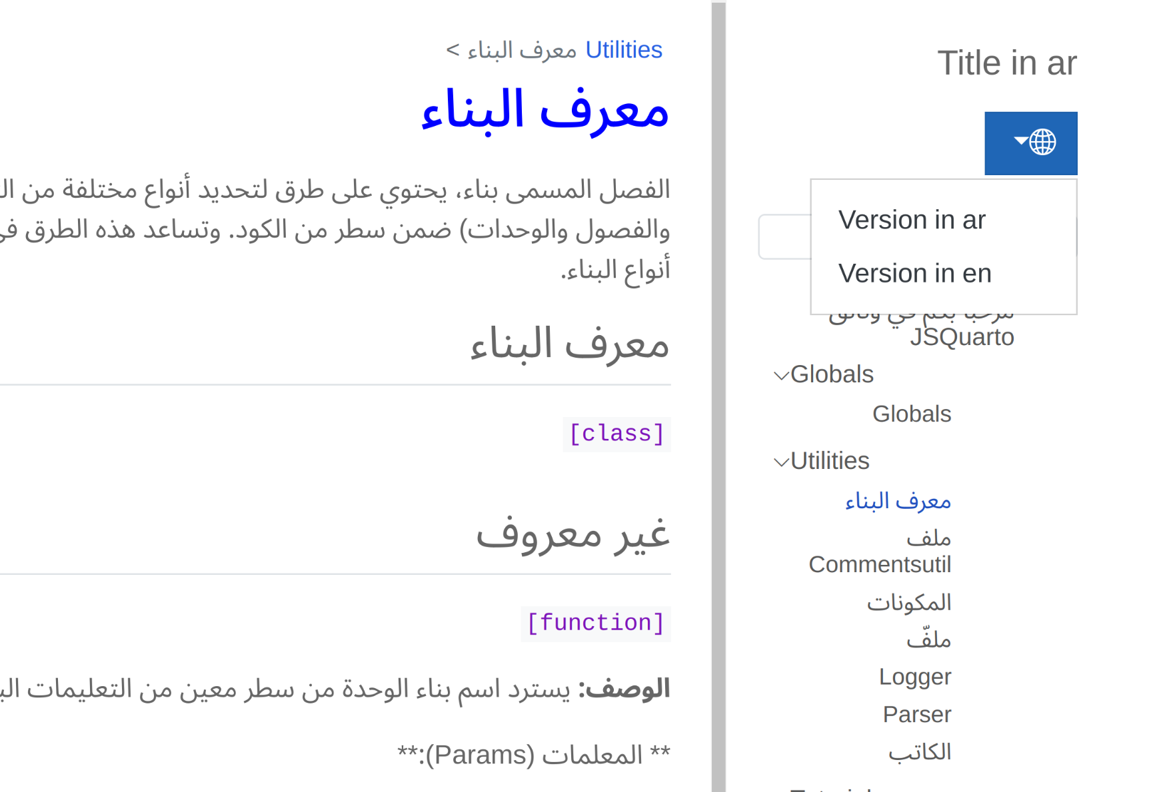
Rendering in multiple languages

Slide 12
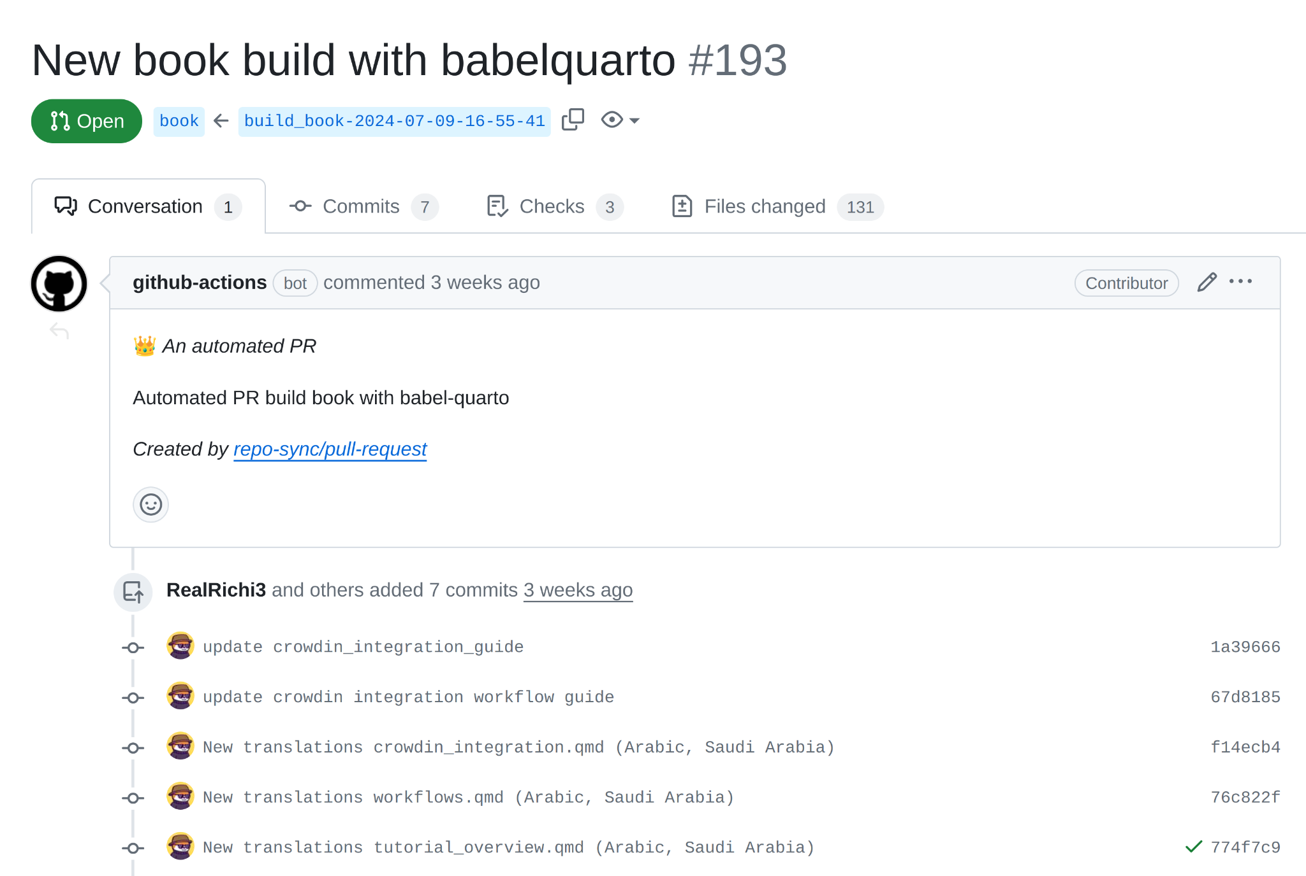
Automation with Github

Slide 13
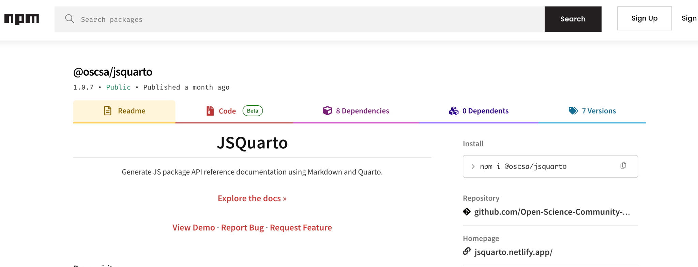
Install JSQuarto via npm

Slide 14

Value of JSquarto
Simplifies process of creating documentation
Supports developers worldwide by providing localised documentation.

Slide 15
Thank you!
Useful Links
Twitter: x.com/MolunoRichie
Book: jsquarto.netlify.app
NPM Package: npmjs.com/package/@oscsa/jsquarto
GitHub: github.com/Open-Science-Community-Saudi-Arabia/JSquarto

